Slide 1
CS 2200
LAB 12

Slide 2
Announcements
Project 5 is released and is due April 22nd @ 11:59pm
NO LATE DAYS can be used for this project
Project 4 Demos are this week. PLEASE DO NOT MISS YOUR DEMO!
Homework 9 will be released tonight and is due April 17th. (It covers networking!)
Be on the lookout for TA applications around this weekend/next week

Slide 3
Today’s Topics:
Networking, Protocol Stack, Performance Metrics

Slide 4
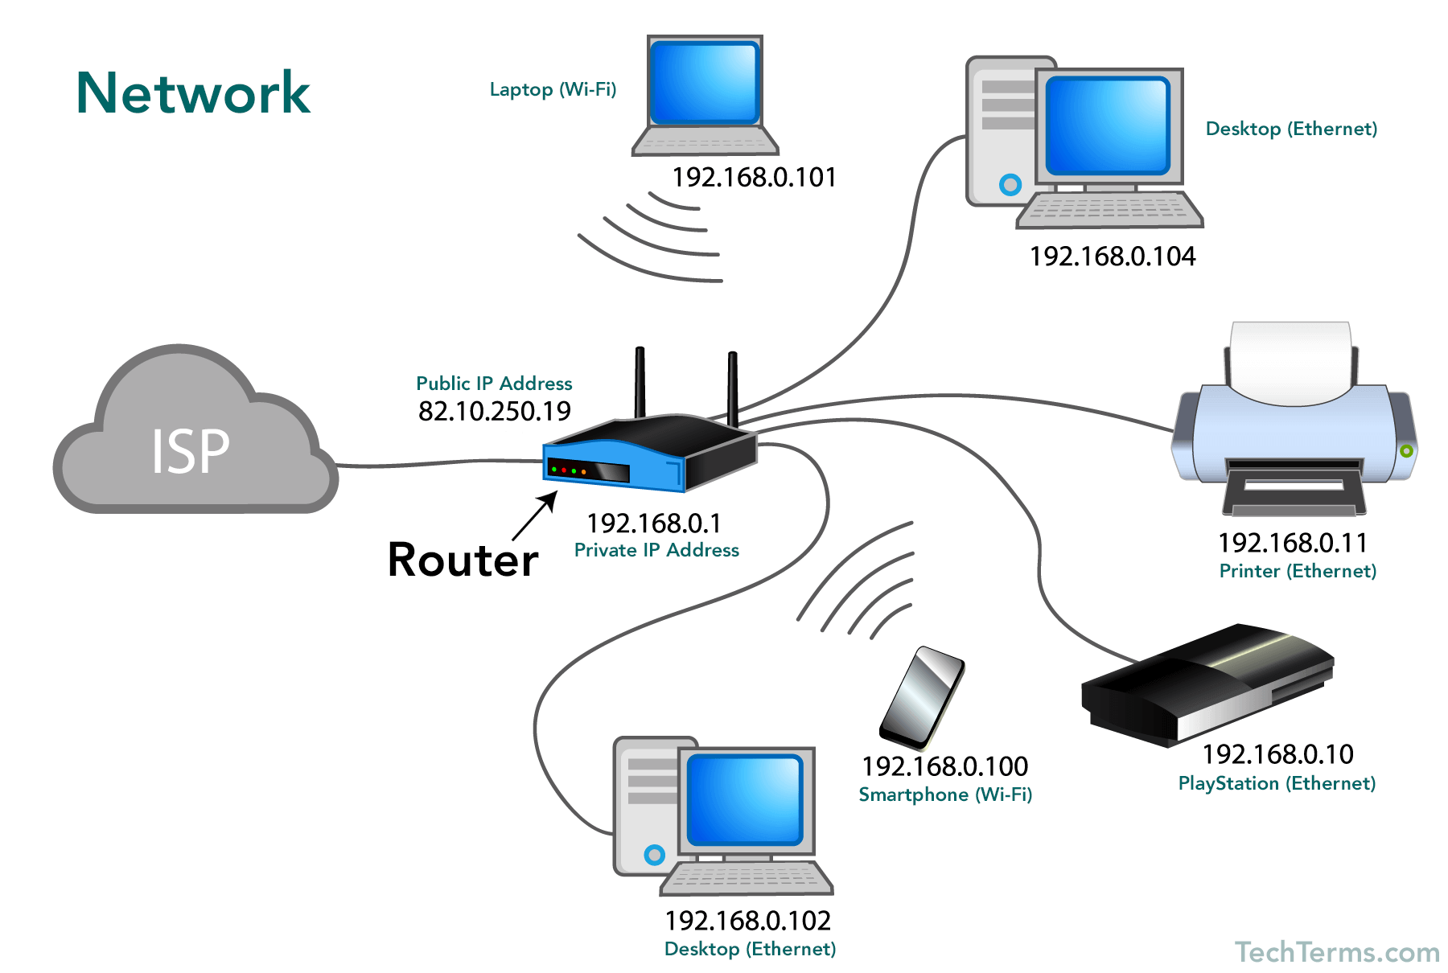
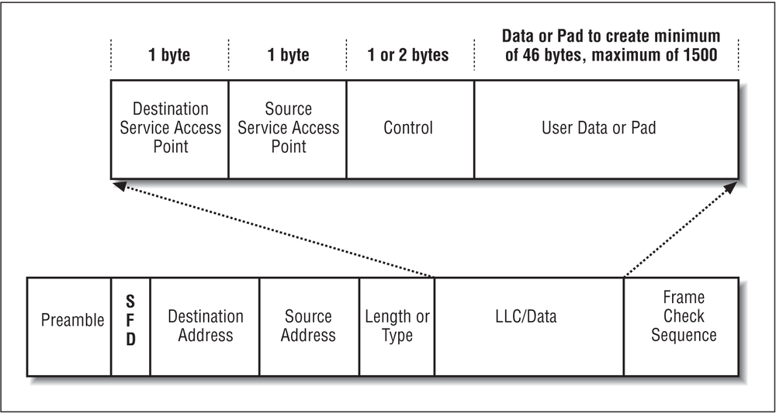
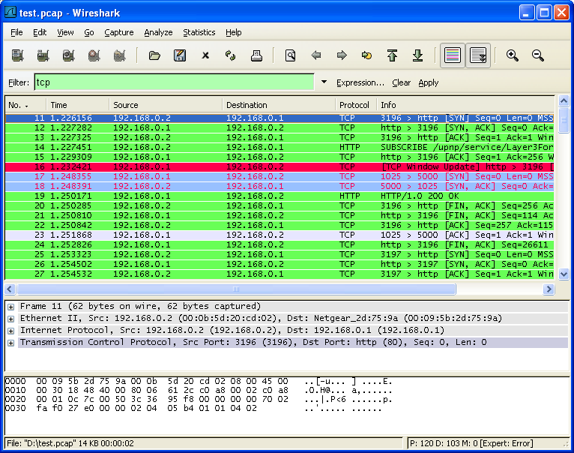
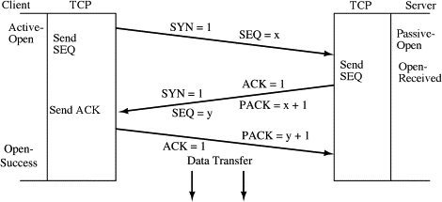
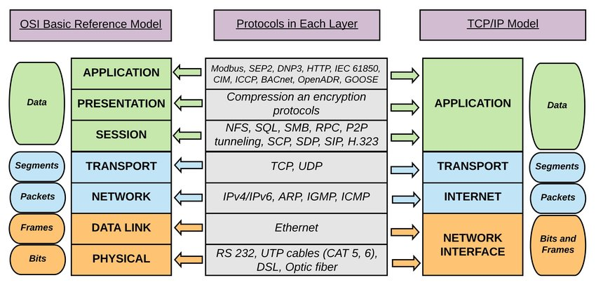
Networking is very extensive.
Goal with networking: establish a standardized format for sharing data between computers.

Slide 5
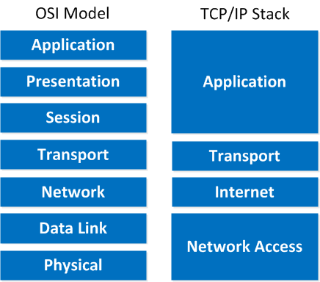
Protocol Stack
Protocol Stack: The procedure that handles network interactions (i.e. receiving data and sending data)
Manages the sending/receiving of data from the network, and avoids issues such as:
Arbitrary message sizes
Out of order delivery
Data loss
Data corruption
Queuing Delays

Slide 6
Protocol Stack
Application Layer (L5) handles the data for applications that send messages (ex: web apps, email)
Transport Layer (L4) handles organizing message fragments.
Messages being received move “up the stack”
Messages being sent move “down the stack”
Network Layer (L3) determines where packets should be sent next.
Link Layer (L2) performs the actual sending/receiving of frames.
Physical Layer (L1) performs the physical/electrical movement of the bits from one network node to another.

Slide 7
Network Layer
Network Layer (L3) determines where packets should be sent next.

Slide 8
Network Layer
Deals with routing packets.
Analogy: Postman reading an envelope address, and sending a letter towards its mailing address.
Given a packet from the transport layer, the network layer finds a way to get the packet to the intended destination.
If this node/computer is the packet’s destination, then the network layer will pass that packet up to the transport layer.
The Network layer commonly follows a standard procedure for routing packets: Internet Protocol (IP)

Slide 9
Packets
What’s stored in a packet?
Header
Destination and Source Address
NUM_PACKETS (P5 uses LAST_DATA) so we know when all packets have arrived
Sequence number
Packet size
Checksum
Payload
The actual data being sent

Slide 10
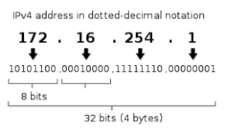
IP Addresses
We need to be able to index and identify nodes in our new, more complicated network
IPv4 addresses are 32 bits (IPv6 are 128)
Normally written as p.q.r.s/n
p,q,r,s are 8 bits each
n denotes how many bits are in the network part of the address (also called the subnet mask)
32 - n = # of bits to identify the host on the network

Slide 11
IP Addresses, cont’d
Rules of IP routing
If on the same network, send to link-layer for transmission
If on different networks, use IP routing table to forward to another IP host
Determine if on the same network using the network part of the address
Have different port numbers to keep track of different conversations
HTTP is port 80, HTTPS is port 443, etc
Can use a firewall to allow/disallow incoming/outcoming traffic; keeps track in a local state table/connection table
Also can do protocol verification to drop verification to drop malicious/badly-formed traffic
NAT (Network Address Translation) remaps an IP in one address space (usually private) to one in another (usually public)
Used often in IPv4 because we ran out of IPv4 addresses — we can save space by not making new public IP addresses, and reusing old ones.

Slide 12
Exercise: Subnets
Given the subnet mask 255.255.255.0 (n = 24 bits), determine which devices are on the same network
For each identified network provide the Network ID
Device: | IPv4 Address:
Device 1 | 128.164.63.34
Device 2 | 128.164.107.124
Device 3 | 128.246.175.93
Device 4 | 128.164.63.245

Slide 13
Solution: Subnets
Network 1
Device 1, Device 4
NetID - 128.164.63.0
Network 2
Device 2
NetID - 128.164.107.0
Network 3
Device 3
NetID - 128.246.175.0
Device: | IPv4 Address:
Device 1 | 128.164.63.34
Device 2 | 128.164.107.124
Device 3 | 128.246.175.93
Device 4 | 128.164.63.245

Slide 14
Address Resolution Protocol (ARP)
How do we connect both the link and the network layer?
When you need to know an MAC address, broadcast a message asking who has the corresponding address
Host responds that they have it – that frame also contains their MAC address (it’s in the header!)
Keep track of an ARP Table with these mappings; discard entries when they are stale

Slide 15
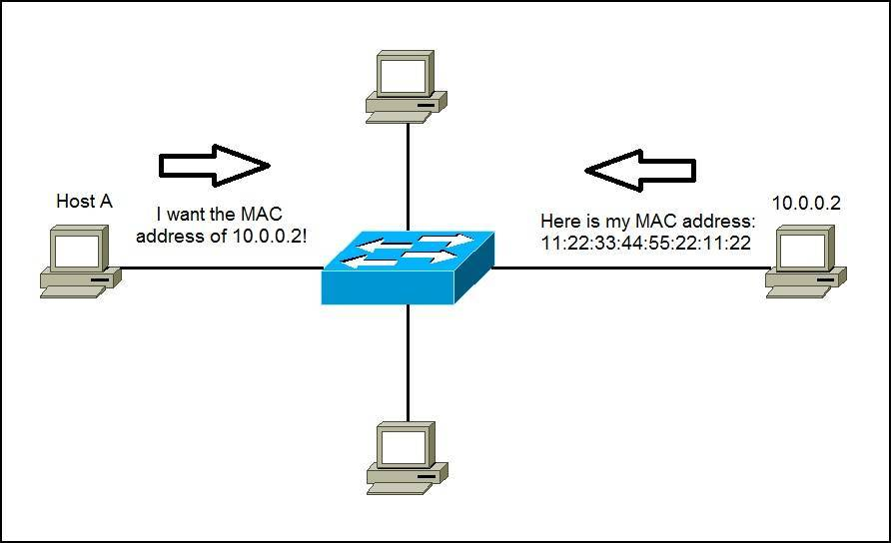
ARP in a picture

Slide 16
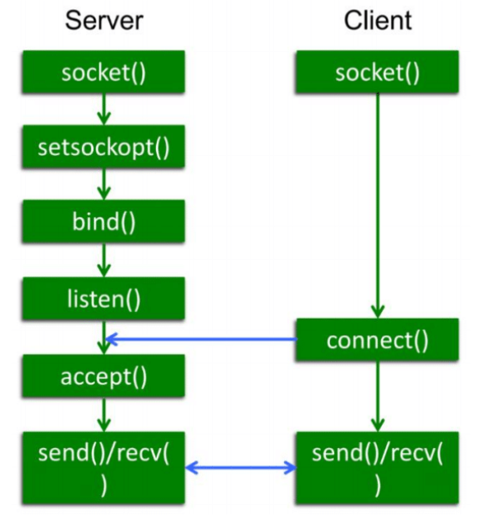
Network Socket Programming
General paradigm:
Server sets up a listener bound to a certain destination point
Client makes a connect request to the listener
The listener accepts the connection
Client and server can communicate using send/recv (write/read) syscalls
Can use a higher-level abstraction for a client to call a procedure on a server — a remote procedure call (PRC)

Slide 17
Transport Layer
Transport Layer (L4) handles organizing message fragments.

Slide 18
Transport Layer – Overview
Performs Packetizing
Breaking messages/data from application layer into packets to be transported
Stop and Wait protocol
Sender sends packet
Receiver receives packet
Receiver sends ACK (acknowledgement)
Sender waits for ACK, re-sends package if no ACK is received in a time window
Receiver re-sends ACK if sender re-sends the packets
This protocol is rather slow — have to wait for messages to be sent and acknowledged packet by packet
Need to ensure packets don’t get mixed up in transport
Give them a sequence number

Slide 19
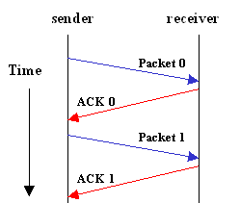
Stop and Wait
Sender sends one packet at a time and waits to be acknowledged before sending the next packet
If no response is received within a certain time frame, retransmit the packet
Most simple transmission protocol
How many bits are needed for SEQ and ACK #s?

Slide 20
Stop and Wait
Sender sends one packet at a time and waits to be acknowledged before sending the next packet
If no response is received within a certain time frame, retransmit the packet
Most simple transmission protocol
How many bits are needed for SEQ and ACK #s?
Only 1, Why???
(hint: stop and wait is also known as alternating bit protocol)

Slide 21
Exercise: Stop and Wait and Sliding Window
Given a reliable network, how long would it take to transmit 100 packets if the Round Trip Time was 4ms using Stop and Wait?
How long for Sliding Window with a window size of 5 packets and a RTT of 4ms? Assume that the time (overhead) to send and receive packets is negligible.
Notes:
Time until sender receives the final ACK

Slide 22
Solution: Stop and Wait and Sliding Window
Given a reliable network, how long would it take to transmit 100 packets if the Round Trip Time was 4ms using Stop and Wait?
100 packets * 4ms = 400 ms
How long for Sliding Window with a window size of 5 packets and a RTT of 4ms? Assume that the time (overhead) to send and receive packets is negligible.

Slide 23
Solution: Stop and Wait and Sliding Window
Given a reliable network, how long would it take to transmit 100 packets if the Round Trip Time was 4ms using Stop and Wait?
100 packets * 4ms = 400 ms
How long for Sliding Window with a window size of 5 packets and a RTT of 4ms? Assume that the time to send and receive packets is negligible.
Within the RTT of 4ms, 5 packets would have completed transmission. There are 100/5 = 20 windows that must complete. 20*4ms = 80ms

Slide 24
Pipelined Transmission
Sender sends a stream of packets before waiting for an acknowledgement
Do we need to acknowledge every packet? Depends…
Reliable Pipelined Transmission
Receiver acknowledges each packet individually
Use a sliding window of packets and wait for ACKS
When the first packet gets an ACK, move the window over

Slide 25
TCP and UDP

Slide 26
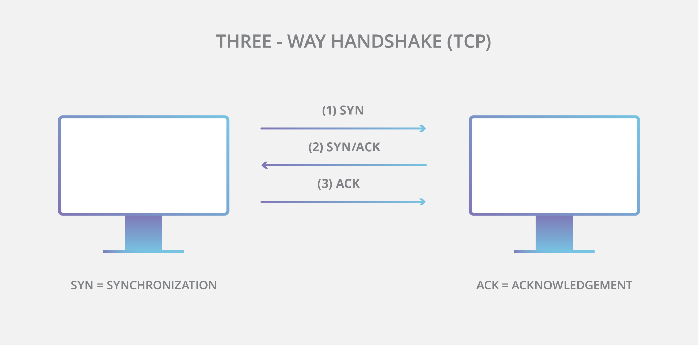
TCP Overview
Connection Oriented
Must perform 3-way handshake to create a connection before sending data
Reliable, in order delivery
Higher overhead than UDP

Slide 27
TCP Overview
Connection Oriented
Must perform 3-way handshake to create a connection before sending data
Reliable, in order delivery
Higher overhead than UDP

Slide 28
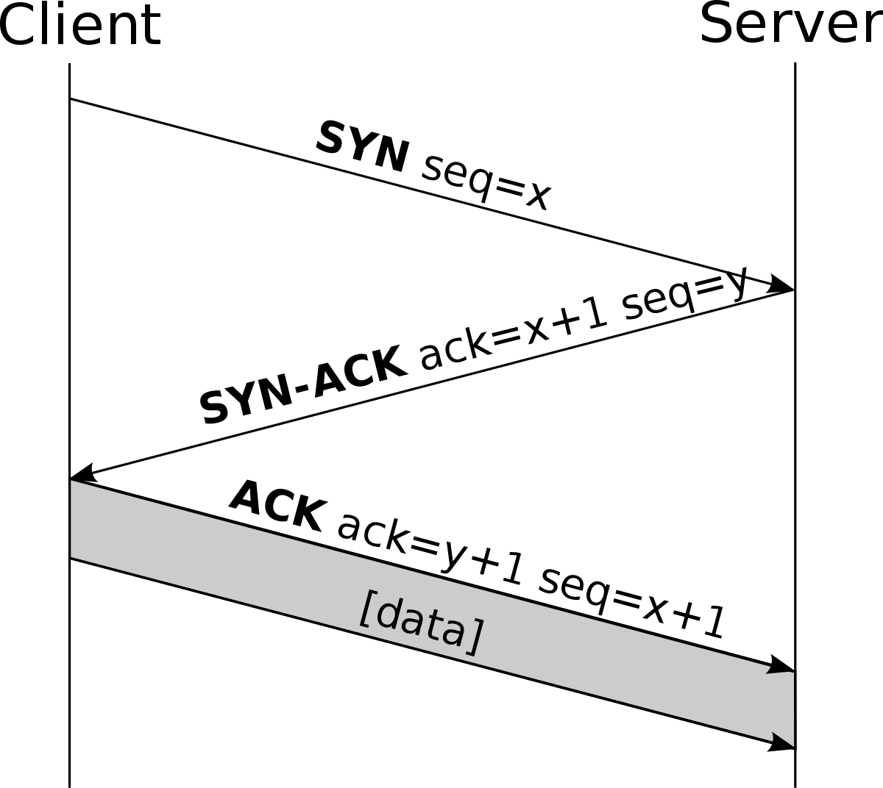
TCP Handshake
Step 1 (SYN): First, a connection between server and client is established. The client node sends a SYN (Synchronize Sequence Number) data packet over an IP network to a server on the same or an external network. This SYN packet is a random sequence number that the client wants to use for the communication.
Step 2 (SYN/ACK): Server responds to the client request with SYN-ACK signal bits set. Acknowledgement(ACK) signifies the response of the segment it received and SYN signifies with what sequence number it is likely to start the segments with.
Step 3 (ACK): In the final part client acknowledges the response of the server and they both establish a reliable connection with which they will start the actual data transfer.

Slide 29
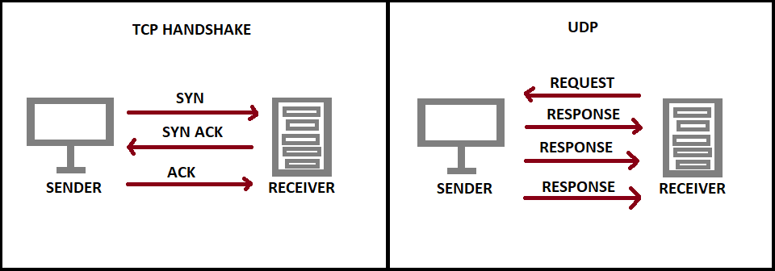
User Datagram Protocol (UDP)
User datagram protocol (UDP) operates on top of the Internet Protocol (IP) to transmit datagrams over a network. UDP does not require the source and destination to establish a three-way handshake before transmission takes place. Additionally, there is no need for an end-to-end connection.

Slide 30



Exercise: TCP vs. UDP
Label the following as using TCP or UDP
Instant Messaging
Video calling
Email

Slide 31
Exercise: TCP vs. UDP
Label the following as using TCP or UDP
Instant Messaging
Video calling
Email
TCP
TCP
UDP

Slide 32
Networking Performance Metrics

Slide 33
Performance Metrics
Transmission time or end-to-end latency = S + Tw + Tf + R
S = processing overhead at sender
Tw = wire delay; how long it takes to put the message on the network
Tf = flight time and/or queueing delay; how long for message to go from end to end on the wire
R = processing overhead at receiver
S and R determined by OS implementation of protocol stack
Message throughput = message-size/end-to-end latency

Slide 34
Performance Metrics
Transmission time / end-to-end latency = S + Tw + Tf + R
S = processing overhead at sender
Tw = wire delay; how long it takes to put the message on the network
Tf = flight time / queueing delay; how long for message to go from end to end on the wire
R = processing overhead at receiver
S
Computer A
Computer B
R
wire delay
flight time

Slide 35
Performance Metrics Example 1
Consider the following scenario:
You are sending a file of 50KB (not KiB) from your phone to your friend’s computer. You are playing games on your phone while sending the file and thus slowing the processing delay down to 7ms. You are using a 5G network with 400Mbps bandwidth. Your friend’s computer requires 2ms for processing overhead. Assume the time of the flight to be 10ms.
What’s the transmission time and throughput in this case?
Note that, in the context of networking, 1Mbps = 1000Kbps, and the lower case b stands for bit. We are using 1MB = 1000KB where B stands for Byte. However, file system normally use 1MiB = 1024KiB.

Slide 36
Performance Metrics Example 1
S = 7ms
Tw = 50KB/400Mbps = (50*8)K bits/(400*1000)Kbps = 400K bits/400000Kbps = 1/1000 s = 1ms
Tf = 10ms
R = 2ms
Transmission time = 7+1+10+2 = 20ms
Throughput = 400 Kbits / 20ms = 20 Mbits/s

Slide 37
Performance Metrics Example 2
Now assume that you are using TCP to transfer the file. The size of each TCP packet is 6KB and the size of the header is 1KB. The window size is 5. For simplicity, assume the processing delay and receiving delay to be 0. Assume the size of the ACK to be 0.
All other conditions remain the same:
400Mbps bandwidth, time of the flight 10ms, 50KB file.
What is the total time taken to complete this file transfer?

Slide 38
Performance Metrics Example 2
Size of file carried by each packet: 6KB - 1KB = 5KB
Number of packets required: 50KB/5KB = 10
Wire delay for each packet: 6KB/400Mbps =0.00012s = 0.12ms
Wire delay 5 packets (window size 5): 0.12*5=0.6ms
Time taken for the receiver to receive the fifth packet: 0.6+10 (flight time)=10.6ms
Time taken for ACK: 0/400Mbps+10=10ms
Time taken from the beginning until the sender receives the 5th ACK (aka last ACK for the first window): 10.6+10=20.6ms
Time taken from the beginning until the receiver receives the last packet: 20.6+0.12+10=30.72ms
Time taken from the beginning until the sender receives the last ACK: 30.72+10=40.72ms

Slide 39
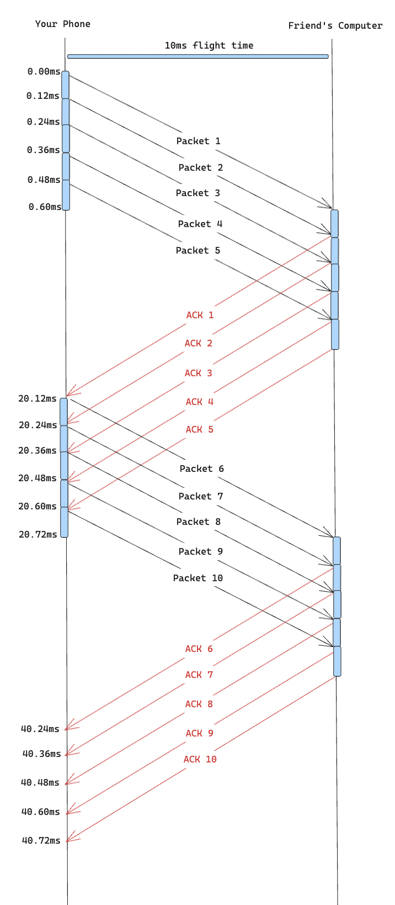
Example 2 Timing Diagram

Slide 40
Thanks for Attending :)

Slide 41
Network Layer — Overview
How do we get a package from the source to the destination?
Link State (LS) / Dijkstra’s Algorithm
Local algorithm with global information
All nodes have complete information about the state of the network
Each node can determine an optimal route
Requires each node to have perfect, updated knowledge of the entire network
Clearly, this is too idealistic….

Slide 42
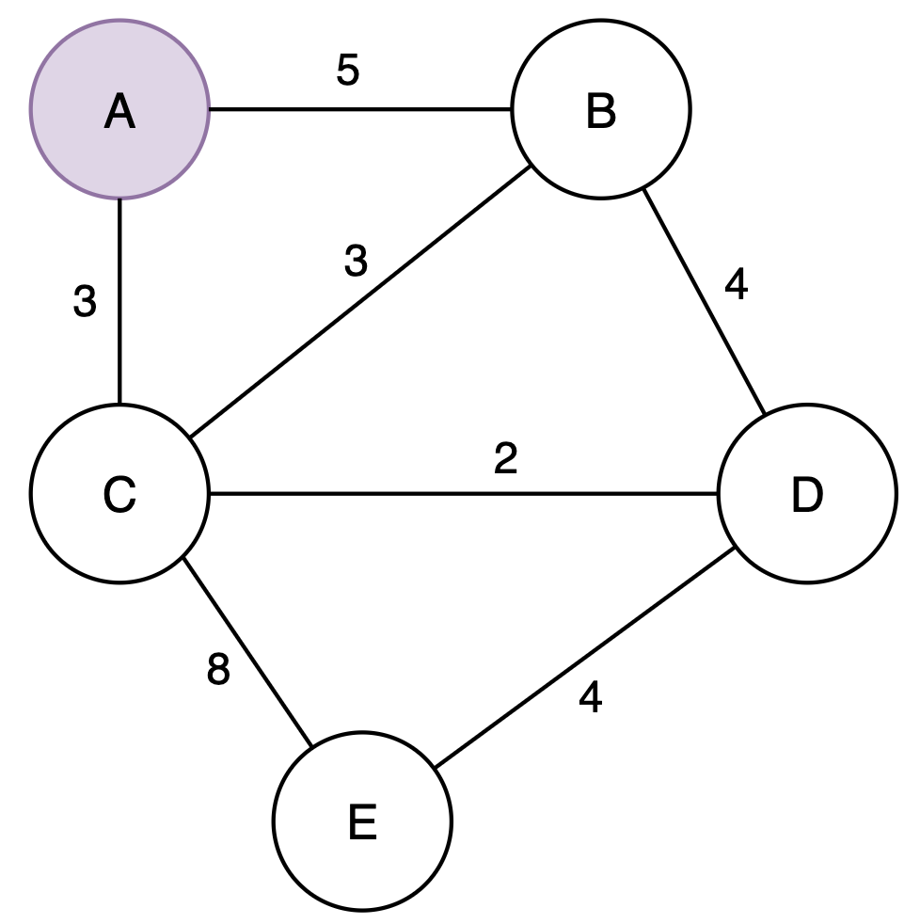
Link State Algorithm Example from Node A

Slide 43
Link State Algorithm Example from Node A
Iter | Traversed | B cost/route | C cost/route | D cost/route | E cost/route
0 | A | 5/AB | 3/AC | - | -
1
2
3
4

Slide 44
Link State Algorithm Example from Node A
Iter | Traversed | B cost/route | C cost/route | D cost/route | E cost/route
0 | A | 5/AB | 3/AC | - | -
1 | AC | 5/AB | 3/AC | 5/ACD | 11/ACE
2
3
4

Slide 45
Link State Algorithm Example from Node A
Iter | Traversed | B cost/route | C cost/route | D cost/route | E cost/route
0 | A | 5/AB | 3/AC | - | -
1 | AC | 5/AB | 3/AC | 5/ACD | 11/ACE
2 | ACB | 5/AB |  | 5/ACD | 11/ACE
3
4

Slide 46
Link State Algorithm Example from Node A
Iter | Traversed | B cost/route | C cost/route | D cost/route | E cost/route
0 | A | 5/AB | 3/AC | - | -
1 | AC | 5/AB | 3/AC | 5/ACD | 11/ACE
2 | ACB | 5/AB |  | 5/ACD | 11/ACE
3 | ACBD |  |  | 5/ACD | 9/ACDE
4

Slide 47
Link State Algorithm Example from Node A
Iter | Traversed | B cost/route | C cost/route | D cost/route | E cost/route
0 | A | 5/AB | 3/AC | - | -
1 | AC | 5/AB | 3/AC | 5/ACD | 11/ACE
2 | ACB | 5/AB |  | 5/ACD | 11/ACE
3 | ACBD |  |  | 5/ACD | 9/ACDE
4 | ACBDE |  |  |  | 9/ACDE

Slide 48
Distance Vector Algorithms
Each node maintains a distance vector table
Contains the lowest cost route of sending a packet to each other node in the network for each neighbor
If A has neighbors B, C, and the network contains another node D, this table will contain the shortest routes to D and C through B, and the shortest route to D and B through C
Nodes update table when
They notice a change in the link state of neighbors
Neighbors communicate change in least-path to node
Asynchronous update
Each node doesn’t know the shortest path to each node in the network — just which neighbor is on that path

Slide 49
Initial State - Distance Vector Example
 | Distance to Node
Info at Node | A | B | C | D | E
A | 0 | 5 | 3
B | 5 | 0 | 3 | 4
C | 3 | 3 | 0 | 2 | 8
D |  | 4 | 2 | 0 | 4
E |  |  | 8 | 4 | 0

Slide 50
C sends vector to A - Distance Vector Example
 | Distance to Node
Info at Node | A | B | C | D | E
A | 0 | 5 | 3 | 5 | 11
B | 5 | 0 | 3 | 4
C | 3 | 3 | 0 | 2 | 8
D |  | 4 | 2 | 0 | 4
E |  |  | 8 | 4 | 0

Slide 51
C sends vector to E - Distance Vector Example
 | Distance to Node
Info at Node | A | B | C | D | E
A | 0 | 5 | 3 | 5 | 11
B | 5 | 0 | 3 | 4
C | 3 | 3 | 0 | 2 | 8
D |  | 4 | 2 | 0 | 4
E | 11 | 11 | 8 | 4 | 0

Slide 52
Final State - Distance Vector Example
 | Distance to Node
Info at Node | A | B | C | D | E
A | 0 | 5 | 3 | 5 | 9
B | 5 | 0 | 3 | 4 | 8
C | 3 | 3 | 0 | 2 | 8
D | 5 | 4 | 2 | 0 | 4
E | 9 | 8 | 6 | 4 | 0

Slide 53
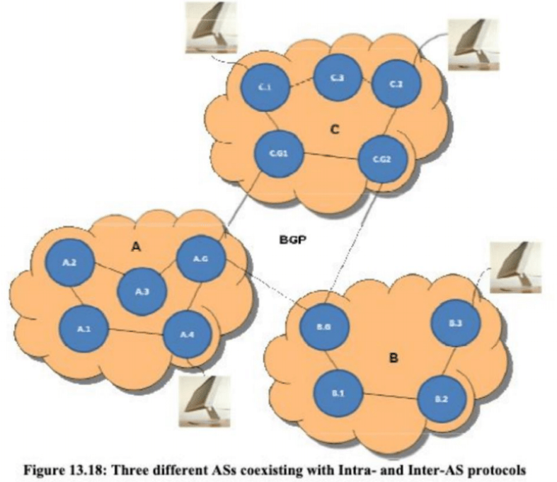
Network Algorithms, cont’d
Both aforementioned algorithms treat neighbors as peers — but the Internet has millions of nodes, so this isn’t going to scale.
Idea: subdivide the internet into Autonomous Systems (ASs), where each one can only see the nodes in the system instead of the entire network.
Called hierarchical routing.
Gateway routers can then communicate to other ASs using the Border Gateway Protocol (BGP).

Slide 54
Physical Layer

Slide 55
Physical Layer — Overview
How do we get information across our physical medium
Physical protocol is a set of rules that governs the data communications between computers on a local network.
Examples of Physical layer protocols include Fiber optics, Ethernet, Universal Serial Bus(USB), Bluetooth, Controller Area Network.
This layer specifies the hardware, cabling, wiring, frequencies, and pulses that are utilized to represent binary signals, among other things.

Slide 56
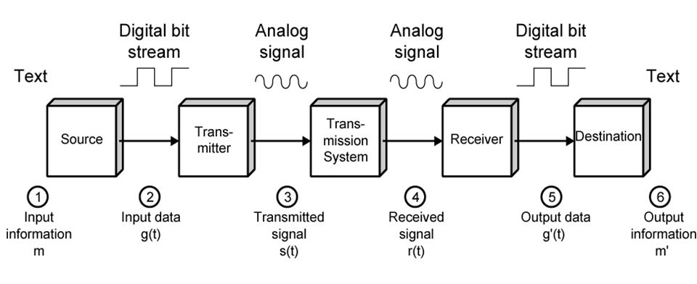
Data Communication Model

Slide 57
What does a Physical Layer Protocol ensure?
Bit Representation: The data in this layer is represented as a stream of bits. For transmission, the bits must be encoded into signals. It specifies the type of encoding, or how the 0s and 1s are converted into signals.
Data Rate: This layer specifies the transmission rate, which is expressed in bits per second.
Synchronization is the process of ensuring that the transmitter and receiver are in sync. At the bit level, the sender and receiver are synced.
Transmission interface between devices and the transmission media is defined by the physical layer.
Line Configuration: This layer connects devices to the media in two ways: point to point and multipoint.

Slide 58
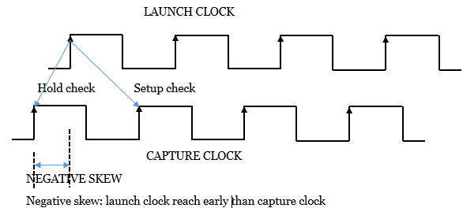
Clock Synchronization and Clock Skew
Clock skew (sometimes called timing skew) is a phenomenon in synchronous digital circuit systems (such as computer systems) in which the same sourced clock signal arrives at different components at different times due to gate or, in more advanced semiconductor technology, wire signal propagation delay. The instantaneous difference between the readings of any two clocks is called their skew.

Slide 59
Manchester Encoding
Use Manchester encoding to represent 1s and 0s (came up for CSMA/CD)
Transmit binary data over communication channels
Always is a voltage transition when there is a transmission; when the network is idle, there is no voltage transition
Low to high = 0, high to low = 1, all high or all low = idle
Solves ambiguity of bit encoding – if low is 0 and high is 1, what happens on idle? How do we distinguish between idle and a transmission? (Manchester solves that)

Slide 60
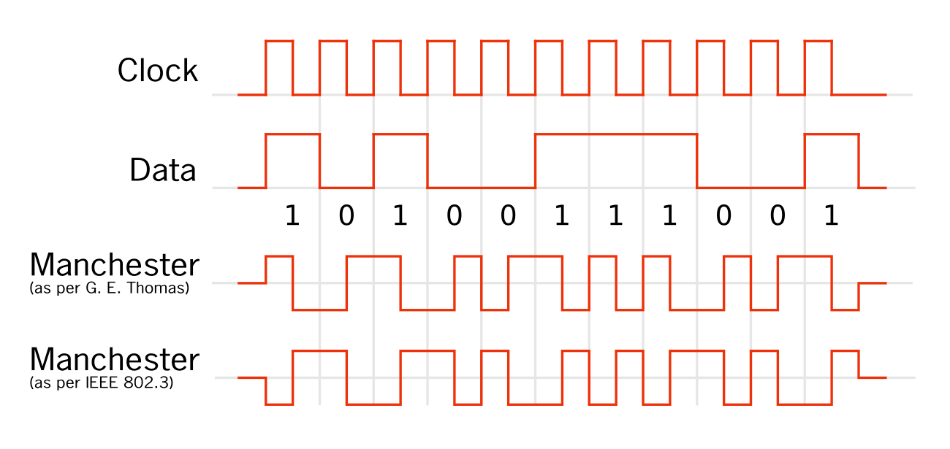

Slide 61
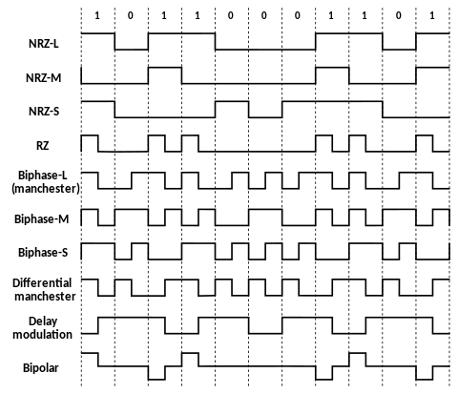
Data Encoding Schemes

Slide 62
Link Layer

Slide 63
Link Layer — Overview
Deals with getting actual access to the physical medium.
Collision domain – all nodes that share a physical ethernet; only one can transmit one at a time.
Broadcast domain – all nodes that can hear a broadcast frame.
MAC(Media Access Control) address – unique address that identifies a computer at the link layer, that is stored on a Network Interface Card (NIC)

Slide 64

Ethernet
Most common Link Layer protocol. Used in wired local area networks (LANs).
Ethernet is a network protocol that controls how data is transmitted over a LAN and is referred to as the IEEE 802.3 protocol.
The protocol has evolved and improved over time to transfer data at the speed of more than a gigabit per second.
Ethernet was built with the assumption that all computers on a network use a shared communication channel.
The primary problem with using a shared connection is creating a sense of orderly traffic when an entire network of computers wants to constantly transmit data over the same channel.

Slide 65
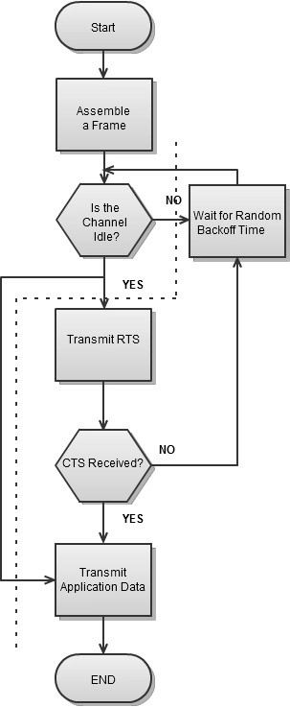
How Ethernet Works (CSMA/CD)
CSMA/CD - Carrier Sense Multiple Access with Collision Detection
Computers within a collision domain can talk to each other, so we need to make sure that the domain is idle before we send our data frame.
The computer will wait to see if it can send, and if it cannot, then it will wait a randomly assigned time.
Nowadays, use switched Ethernet so there are no collisions (see switch discussion below in hardware)

Slide 66
CSMA for Wireless Communication
Can we use CSMA/CD for wireless LAN?

Slide 67
CSMA for Wireless Communication
Can we use CSMA/CD for wireless LAN?
No, we cannot. Undetected collision might occur due to Hidden Terminal Problem.(Where two devices are within range of a common access point, but not within range of each other)

Slide 68
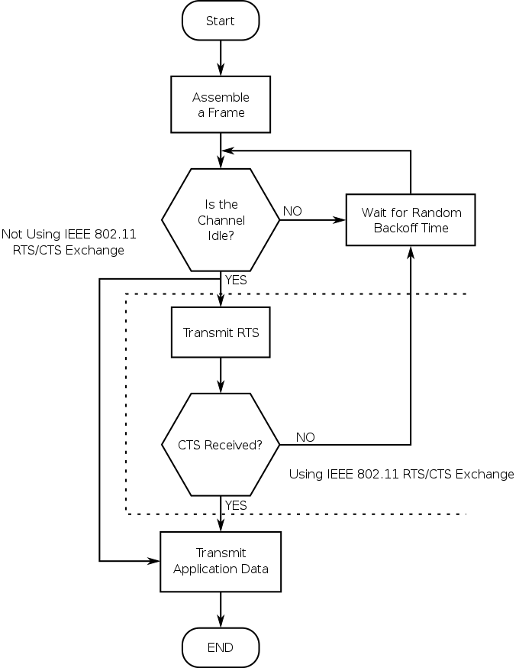
Wireless Communication IEEE 802.11
Uses over-the-air modulation techniques to encode digital data to be transmitted wirelessly.
Struggles with the issue of multiple devices attempting to transmit at the same time. (Hidden Node Problem).
Uses request to send and clear to send signals to prevent data collision.
CSMA/CA - Carrier Sense Multiple Access with Collision Avoidance.

Slide 69
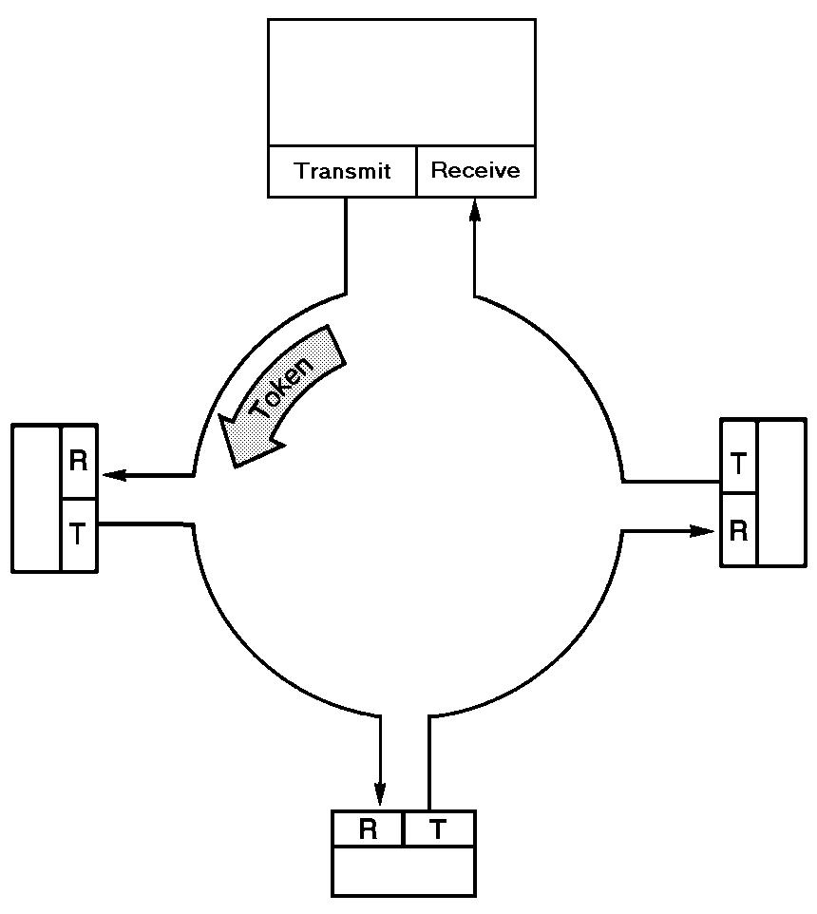
Token Ring
An older form of link layer protocol.
A token (special bit pattern) keeps circulating on a wire.
A node can only send when it has the token; when it transmits a frame, it puts the token back on the wire for someone else to send a frame.

Slide 70
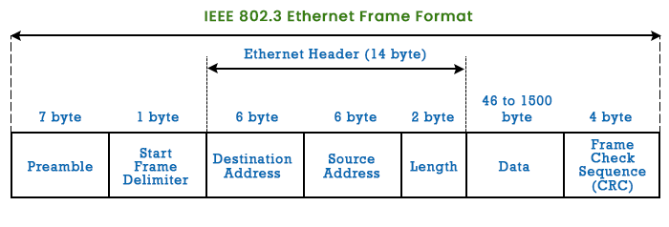
Ethernet Frames

